Slide 1
The bet-ter choice: exploring putative dopamine effects on cost-benefit decision making
4.23.2019
Guillaume Pagnier

Slide 2
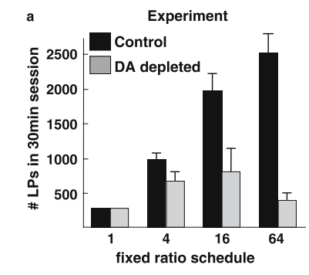
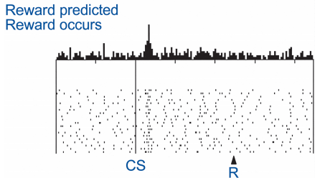
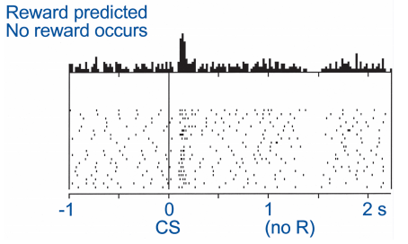
What does dopamine (DA) do?
Lots of things
Future behavior (learning)
Current behavior (performance)
Fast, phasic DA spikes in the striatum occur when participants experience reward prediction errors and modulate learning.
DA lesions leads to akinetic movements and the choice to not pursue rewards
Shultz et al., 1997
Aberman & Salamone 1999
Notes:
Dual aspect of DA. MOTIVATIONAL side of performance, regardless of motivation.

Slide 3
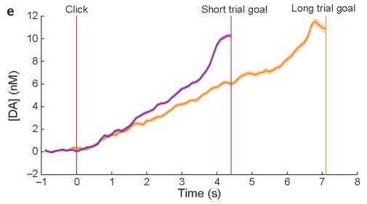
Striatal DA ramps as animals approach a reward
Howe et al., 2013
Hamid et al., 2016

Slide 4
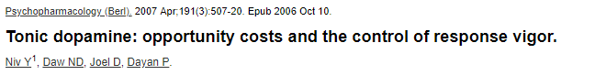
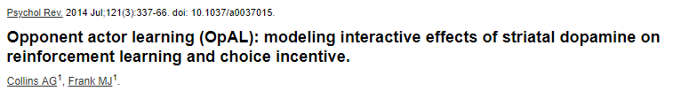
Consequences of high mesolimbic DA
Indiscriminately increasing vigor of any action
Modulates perceived rewards and/or perceived costs
Notes:
OpAL integrates the two purposes of DA I mentioned at the first slide: learning and choice and says that they’re not independent at all, they actually interact with one another. If it was just straight vigor, doesn’t change in preference.

Slide 5
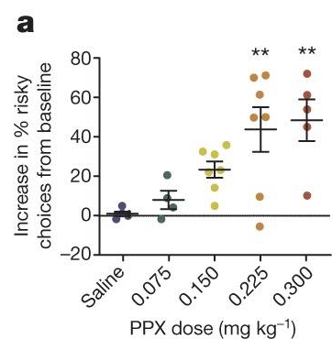
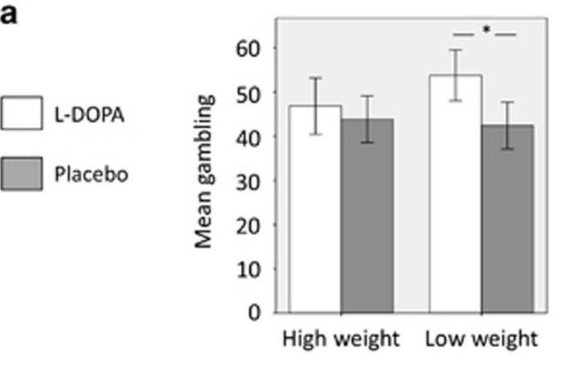
Do fluctuating levels of DA bias value perception?
At different levels of DA, participants may be perceiving value differently.
High DA -> high emphasis on rewards
Zalocusky et al., 2016
Rigoli et al., 2016
i.e. participants should prefer risky gambles and respond
faster as the potential reward is higher
Notes:
Pramipexole – dopamine agonist
Coffee, tea example? Gambles are a good way to probe this as they offer an unambiguous higher reward with a higher potential loss. Explain

Slide 6
Is there a mesolimbic DA ramp in humans and is it robust enough to modulate humans’ gambling behavior?
Notes:
The idea is to get a behavioral measure that such a ramp exists, get data consistent with a ramp and then we could manipulate DA levels pharmacologically. We are NOT saying this has to be BECAUSE of DA.

Slide 7
How to elicit DA ramp?
Gamble?
Gamble?
Gamble?
Howe et al., 2013
Notes:
This is really the question. IS A RAMP APPEARING?

Slide 8
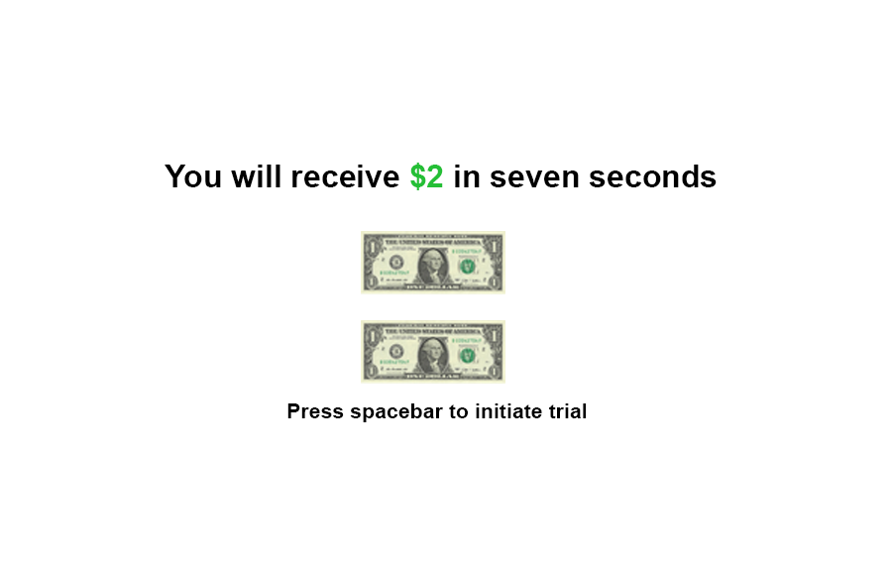
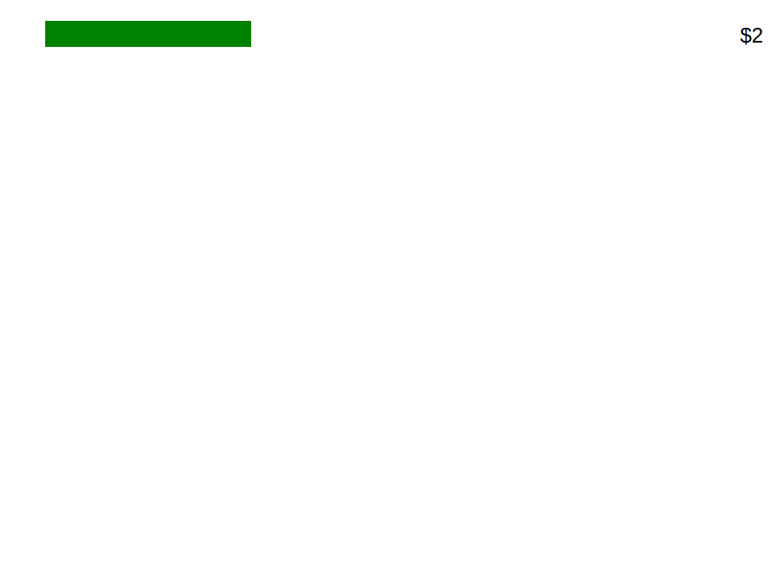
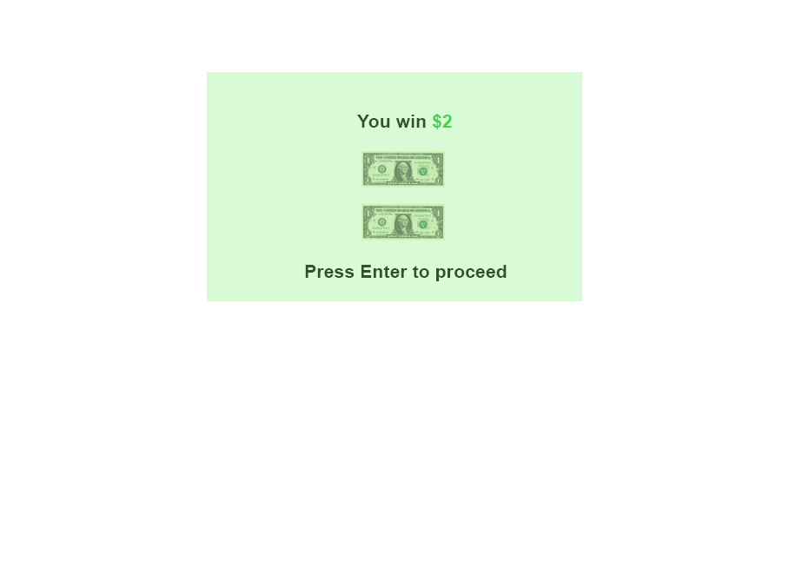

Slide 9
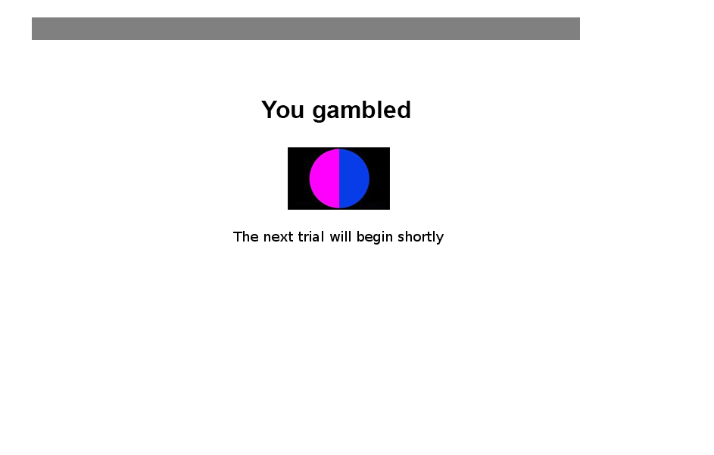
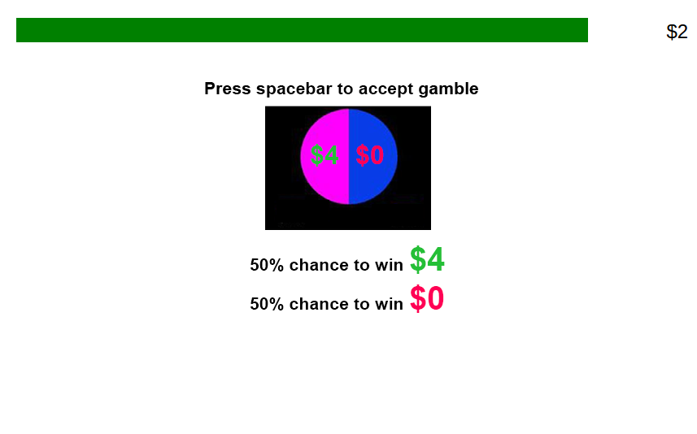
Notes:
Deadline to gamble is the same for each bin. There is NO learning and one gamble is actually paid.

Slide 10
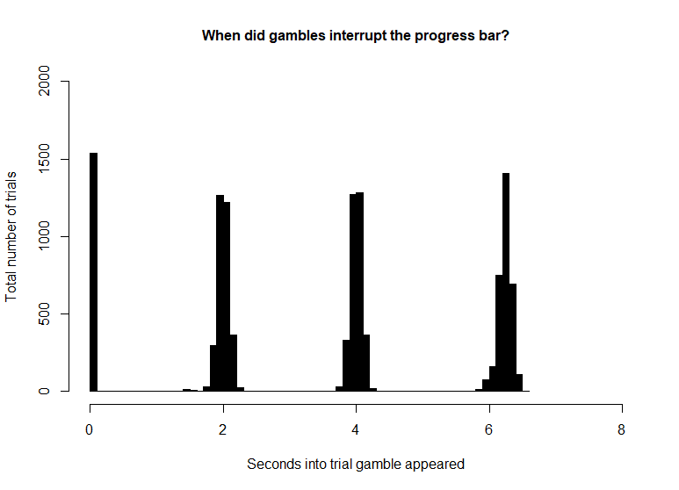
Who’s playing this game?
207 Participants via Amazon’s mechanical turk; (127 male; 76 female; 4 declined to answer)
133 trials (~45 minutes)
Gamble probablilities were always 50%
Gamble losses were always 0$
Magnitude
Low
Trials that offer $1 or $2
Mid
Trials that offer $3 or $4
High
Trials that offer $5 or $6
Value
Low
Gambles that offer 1.5* guaranteed amount
Mid
Gambles that offer 2* guaranteed amount
High
Gambles that offer 3* guaranteed amount
Notes:
Show

Slide 11
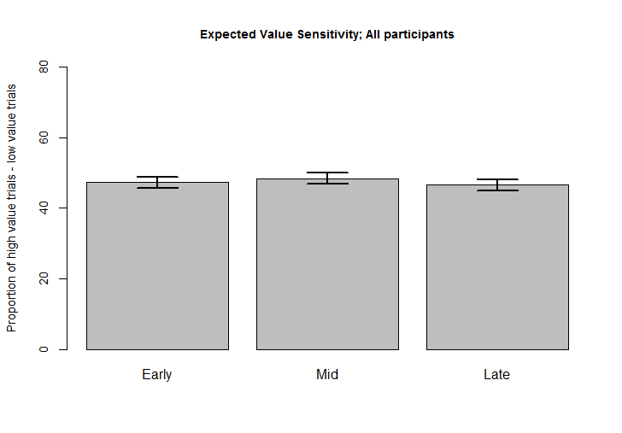
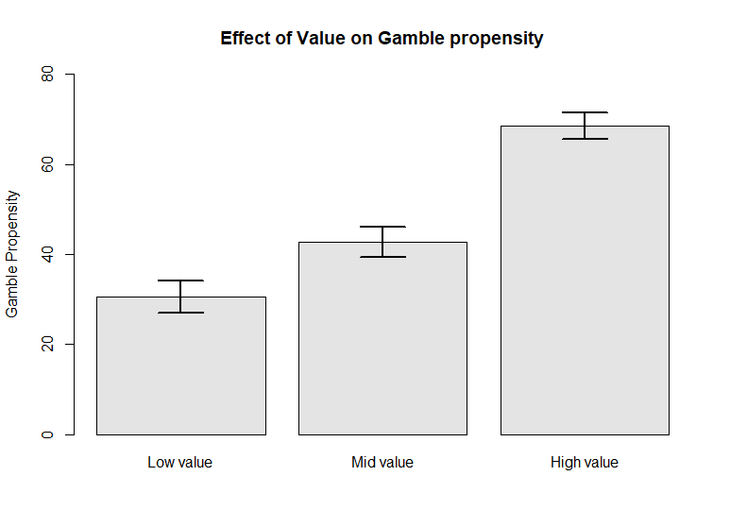
Mturk participants play the task correctly
EV on gamble propensity
EV sensitivity

Slide 12
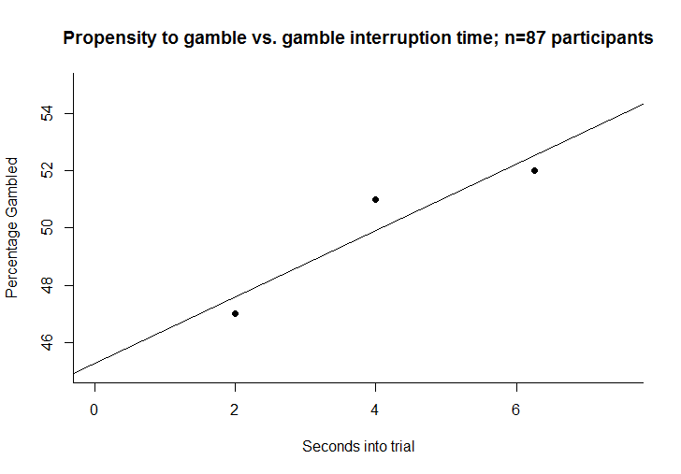
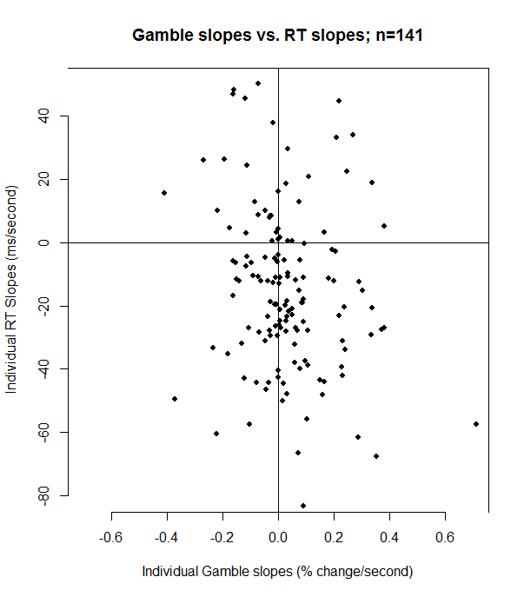
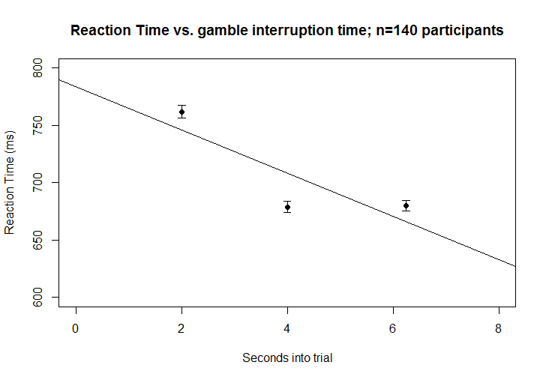
Gamble propensity vs. gamble interruption time
Reaction Time vs. gamble interruption time

Slide 13
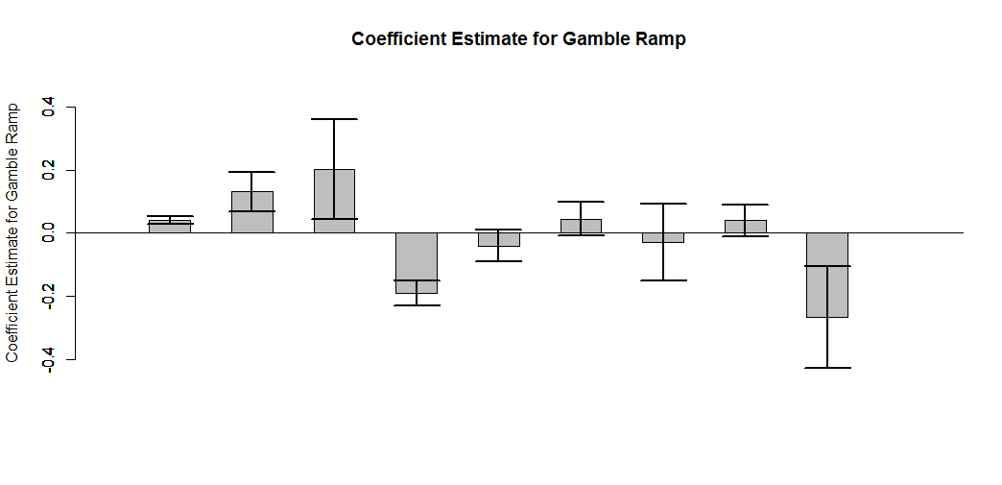
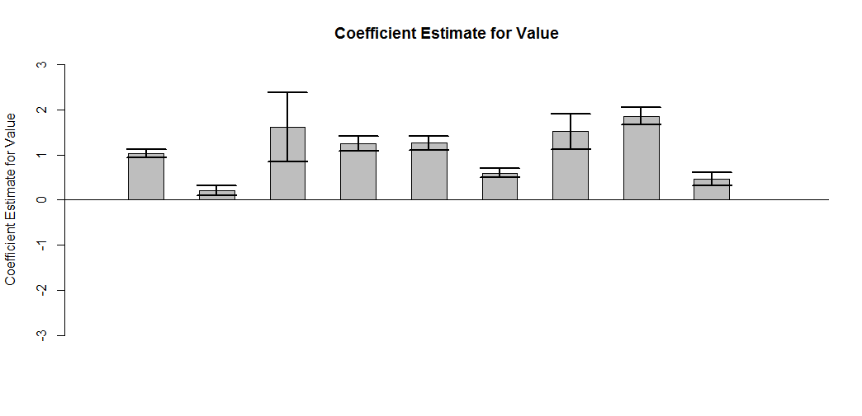
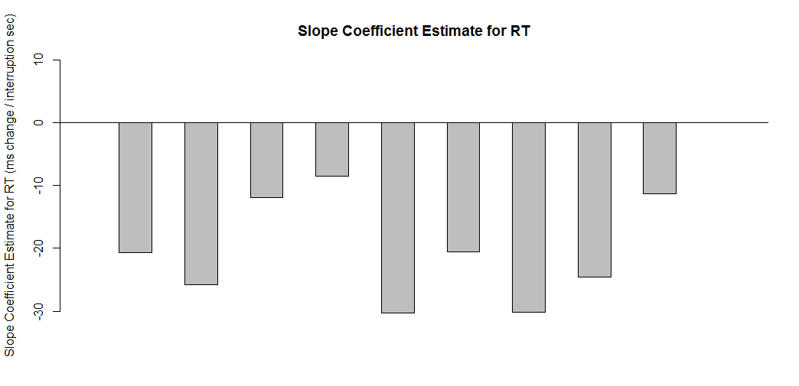
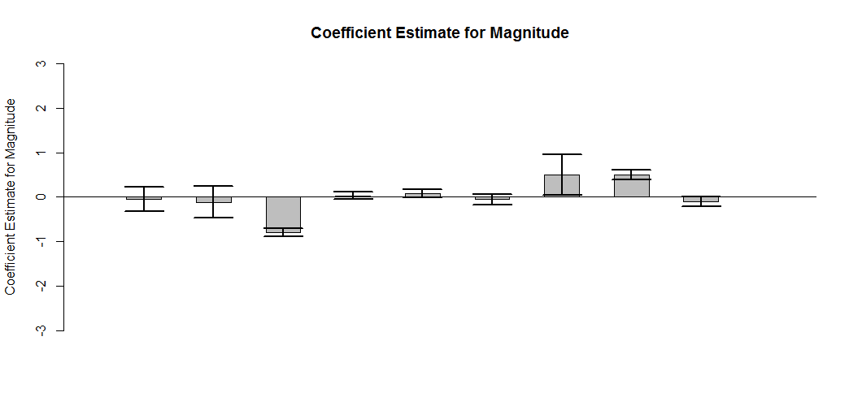
Inconsistent results across experiments
Notes:
Version 1: preview shown for 3 seconds, 8 second progress bar
V02: Gamble preview was shorter, 1 sec shorter progress bar, some aesthetic changes, sfn shown
V03: No preview, instrumental y/n choice in 1.5 seconds
V04: Spacebar to ignore
V05: Color gamble, gamble may be colored blue (activeTrial) or orange (ignoreTrial). For blue gambles, pressing spacebar == gamble. For orange gambles, pressing spacebar == ignores gamble. Each trial’ gamble color for every participant is stochastic. Preview is 3 sec.
V06: ResponseMapping, they have to press a or l depending on which side of the screen its on.
V07: same thing but with a gamble preview of 3 sec
V08: 5 sec gamble bar, not binned anymore, press spacebar (this is now instrumental ramp)
V09: instrumental forced choice, driving progress bar forward..

Slide 14
Summary
Participants recognize advantageous and disadvantageous gambles.
Magnitude doesn’t have an effect on gambling propensity.
Participants RTs tend to decrease as the gamble interrupts later in the progress bar.
Propensity to gamble may be affected by the time at which the gamble interrupts.

Slide 15
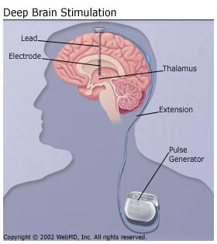
Deep Brain Stimulation (DBS) can be used to treat Parkinson’s disease
Substantia Nigra neurons degenerate
Most common medication = DA agonist
Deep Brain Stimulation (DBS) is sometimes used as a treatment to ‘lesion’ the STN
STN is implicated in recruitment of control behavior.
Notes:
Lesioning the stn with high frequency stim though it’s controversial exactly what it’s doing. High duration high frequency looks like it lesions and thus reduces the output of this global brake pedal. STN implicated in control/potentially model-free like behavior. STN = recruitment of control behavior via Wiecki and Frank 2013. Active during conflict.
DBS affects decision threshold.
High DA =
STN projects to the DA system. Disciminate between orthogonal systems:
Does DBS affect cost/beneft or does it

Slide 16
Does STN DBS affect cost-benefit decision making?
Probably
Notes:
STN high frequency stimulation increases impulsive choice and decreases RT. Recent study showed the opposite that high frequency INCREASED RT and increased safe option. Maybe difference between intermittent and chronic? Interacting with individual differences?
How does DBS stimulation look like DA? Eye blink rate is good proxy.

Slide 17
Using eye blink rate to gauge network activity
Increased DA more eye blinks
Manipulate frequency and amplitude of DBS to capture largest effect on blink rate
Use resulting parameters during cost-benefit decision making task
Bologna et al., 2012
Notes:
Dopamine and eye blink rate are related. Lots of other things affect eye blink rate too though. The idea is to see which parameters affect eye blink rate the most (assuming that’s the biggest effect) and then use those parameters during a gambling task.

Slide 18
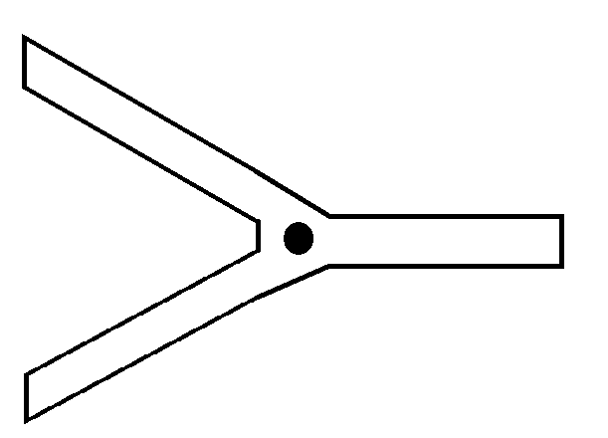
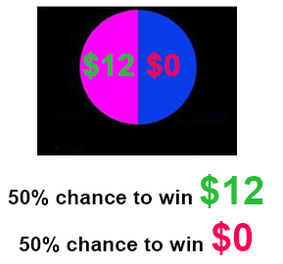
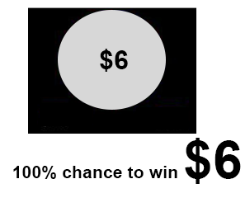
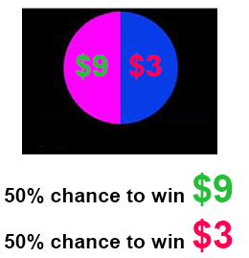
Probing cost-benefit behavior during STN stimulation
Notes:
Use a task that quantifies risk-taking behavior AND motor output.

Slide 19

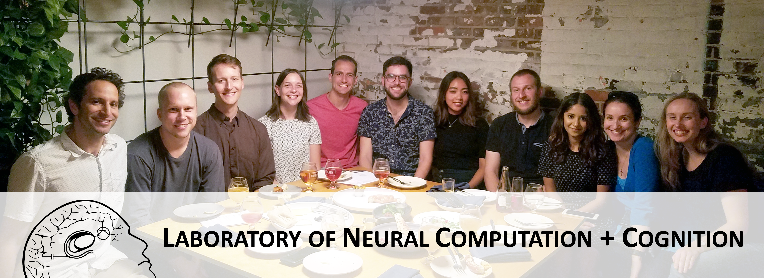
Laboratory of Neural Computational and Cognition
Andrew Westbrook
Andra Geana
Arif Hamid
Andrew Westbrook
Mads Pedersen
Rachel Rac-Lubashevsky
Prannath Moolchand
Louis Gularte
Dan Scott
Harrison Ritz
Amrita Lamba
Alex Fengler
Alana Jaskir
Matthew Nassar
Andrea Mueller
Wasita Mahaphanit
Michael Frank

